Slide 1

JABA Software Systems Inc.
Project: Judas Court Case Management System
Presented by Jennifer Starling

Slide 2
Team Members
Jennifer Starling- Project Manager
Angela Reaves- System Architect
Bonnie Ellis- Database Designer in MySQL
Amir Yousef- Tester

Slide 3
Project Description
The Judas case management system is a prototype court scheduler. It is a web application that has controlled access based on authorized users. Authorized users are assigned access based on their role in the court system. The Judas system allows:
Case records are stored electronically
User to access those cases
Changes to be made to the court case docket list
Changes to the court room schedule.
Correspondence for requests to change the schedule, or a case docket

Slide 4
This Week’s Accomplishments
1) Git Progress:
This week all students were able to get access to the ww2.cs.fsu.edu
2) Log in Screen
The use case description was made for Log in
The log in PHP file was updated using the database schema design by Bonnie, and the MySQL connection for the server database
The Login screen was launched via FSU server with apache/php
3) Clerk Layout started with schedule functionality begun
4) Assignments of the SDS were divided among the group
5) Individual Use Case Packets started by all group members

Slide 5
Next Week’s Work
Have the git access for all users
Begin rigorous testing of the login screen for security purposes
Use Case packet completion of all use cases
Begin implementation of necessary files for Calendar schedule
Begin necessary classes for the Clerk home page functionality

Slide 6
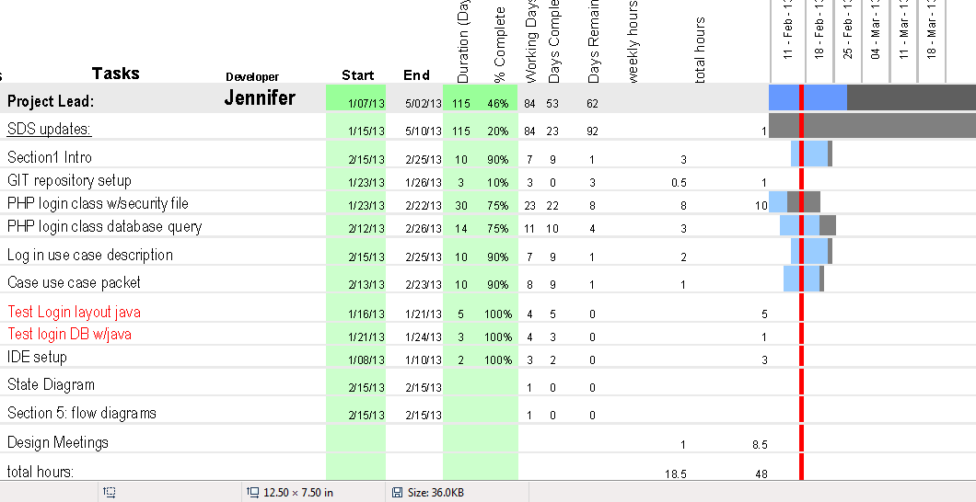
Project Schedule: Jennifer

Slide 7
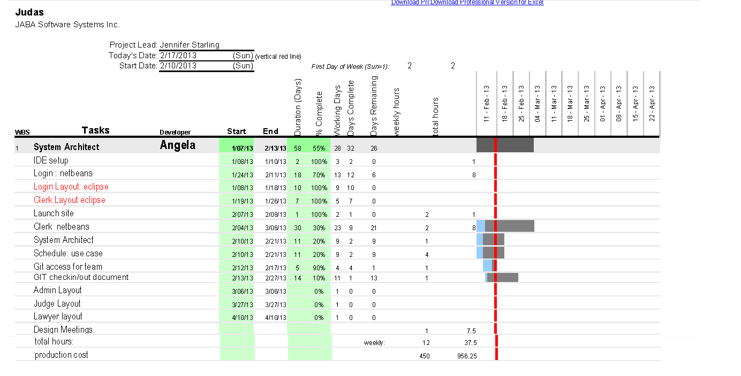
Project Schedule : Angela

Slide 8
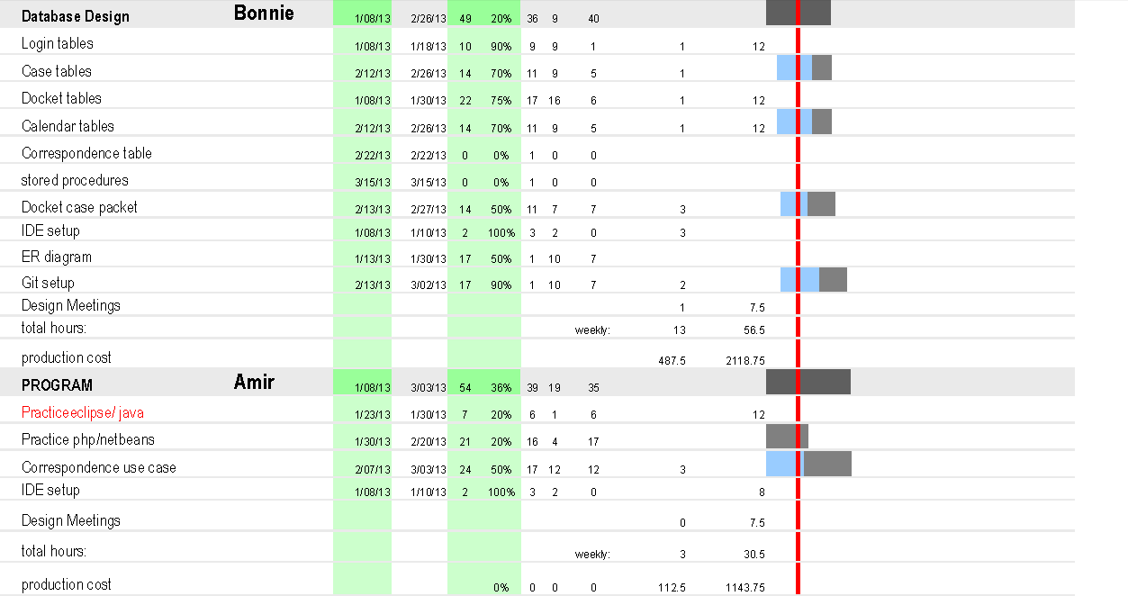
Project Schedule : Amir and Bonnie

Slide 9
Cost to Date
See the Gantt Chart for each team member for a break down of the week’s hours and cost, as well as to date for each member.
Total cost last week = $1743.75 for all 4 members
Total cost since project began this semester = $6018.75

Slide 10
Issues not resolved
We need explicit instructions on how multiple users can access the public_html file that has launched the site from Angela’s directory.
Ticket submitted for our groups git repository with fsu.
Organization of the correspondence classes
Security of the login screen with salting the hashed passwords
Complex MySQL query experience for all team members

